Slide 1

Building a Twitter Clone: Final Report for Minor Project with HTML, CSS, and
JavaScript

Slide 2





Introduction
This presentation will cover the of a Twitter using HTML, CSS, and JavaScript.
We will discuss the and the encountered during the project.

Slide 3








Project Scope
Deﬁning the of the Twitter
and
. Implementing
, and were key aspects of the
,
project.

Slide 4







HTML Structure
Creating the
of the Twitter Dividing the page into
and
and
using HTML.
, ,
sections.

Slide 5





CSS Styling
Applying and to the HTML structure using CSS. Ensuring
and across
different devices and screen sizes.

Slide 6





JavaScript Functionality
Implementing
as
features such
, , and
using JavaScript. Handling and
dynamically.

Slide 7





User Authentication
Securing the Twitter
to ensure
. Managing
.
with
and and

Slide 8
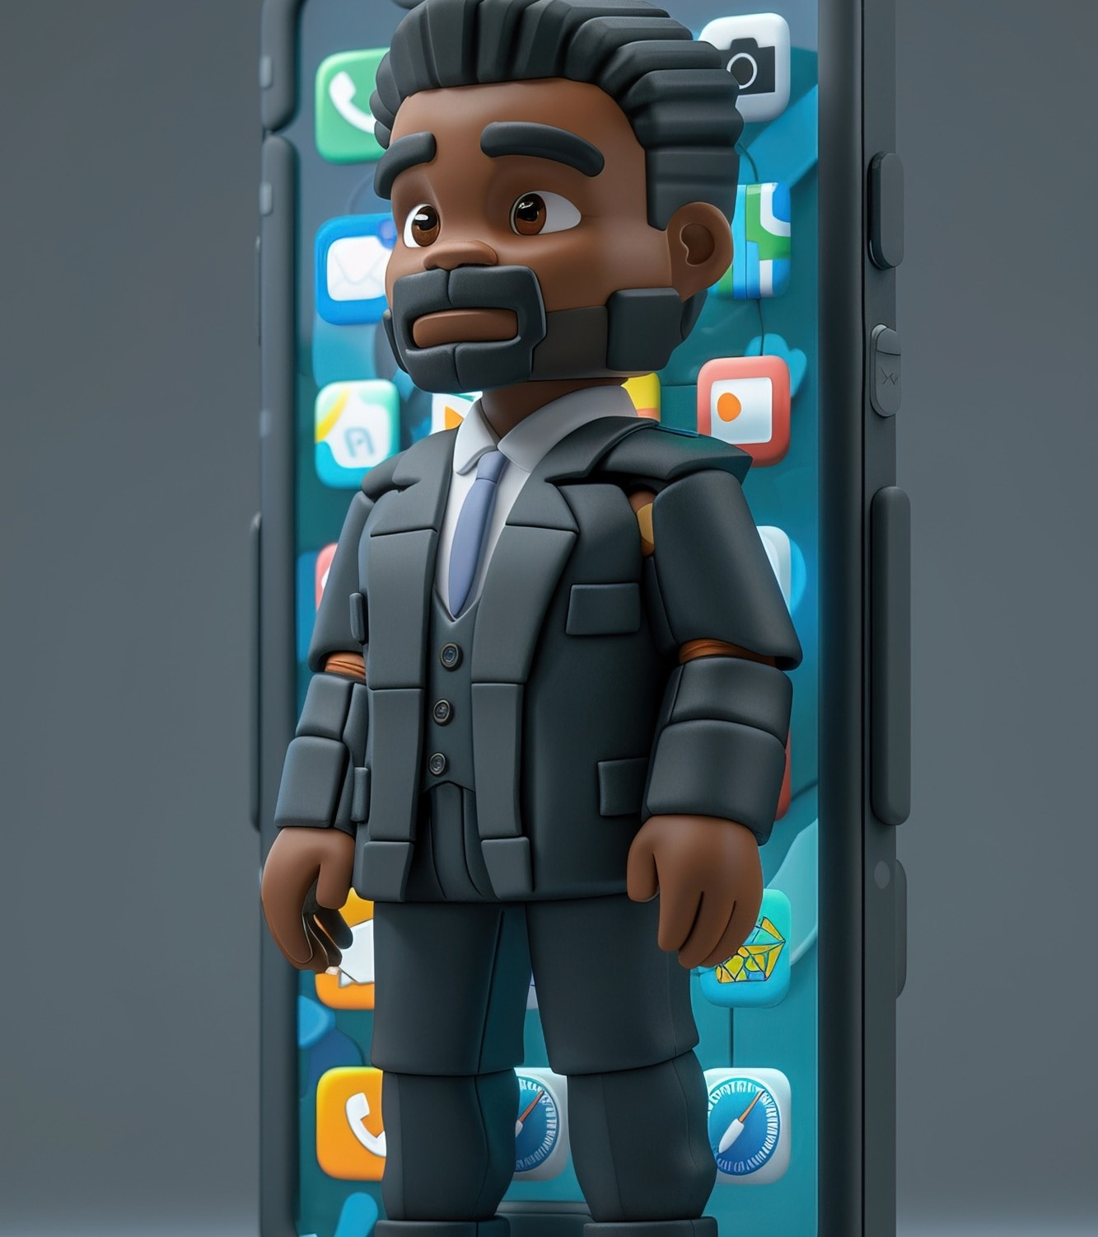





Posting Tweets
Enabling users to
. Implementing and
for user timelines.
and

Slide 9





Following Users
Allowing users to and
other users. Displaying and
for new followers.

Slide 10
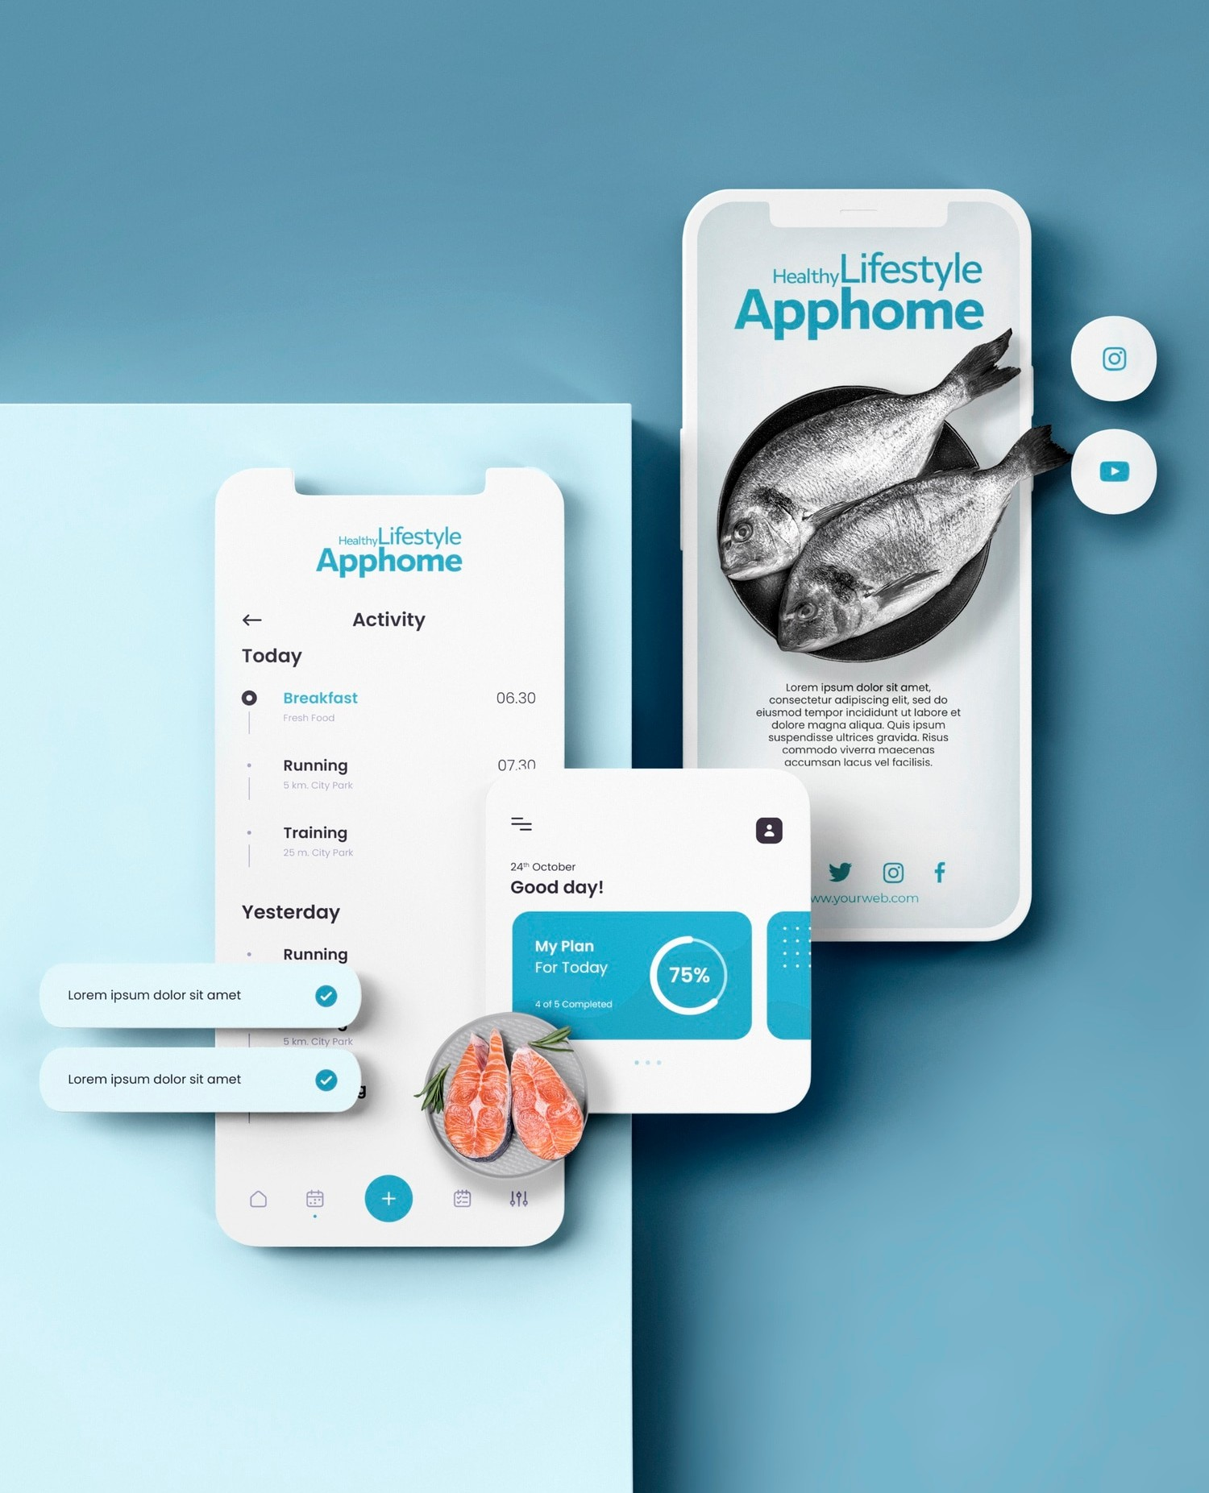





User Experience
Focusing on and to enhance the user
experience. Incorporating
and for improvements.

Slide 11






Challenges Faced
Addressing issues,
, and
.
Overcoming
and
.

Slide 12








Future Enhancements
Exploring such as
, , and
. Continuously
and the Twitter
.

Slide 13






Conclusion
Summarizing the | and | from building
the Twitter | . Emphasizing the | of practical
 | and | .

